Slide 1
GONE WITH THE SOLAR WIND
A Snapshot
of Space Physics at KU
in the 1980s
Mona Kessel
PhD September 1986
now NASA Scientist

Slide 2
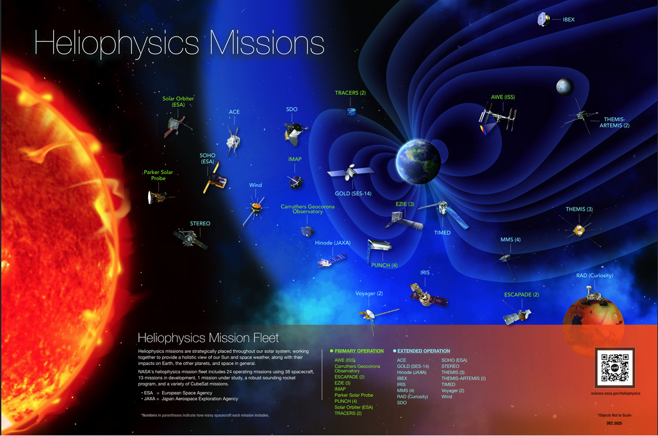

Slide 3
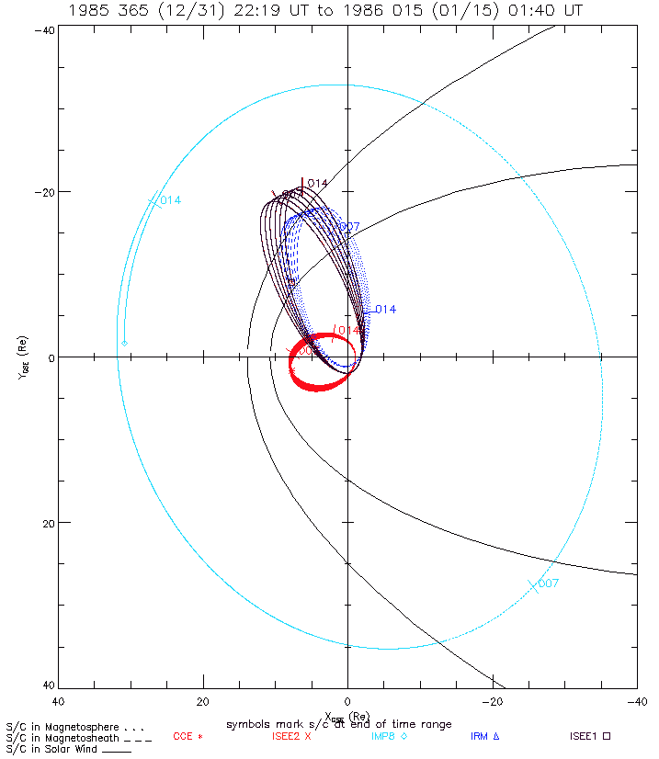
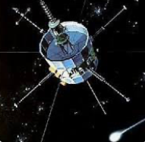
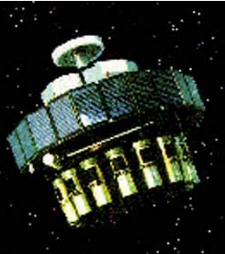
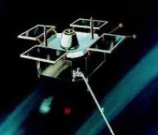
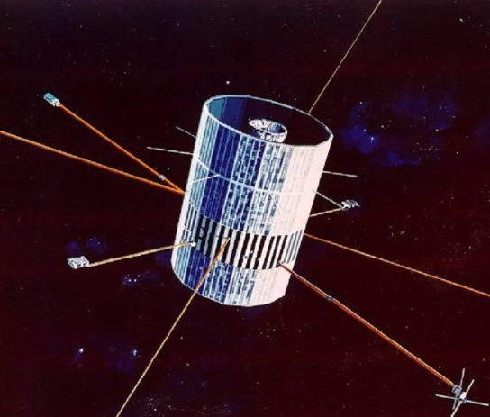
January 1-15, 1986
Bow Shock
Many Fewer Satellite Assets Around Earth
1980 - 1986
ISEE-1/2
AMPTE IRM
AMPTE CCE
Earth
Y_{GSE} (R_{E})
IMP-8
Magnetopause
X_{GSE} (R_{E})

Slide 4
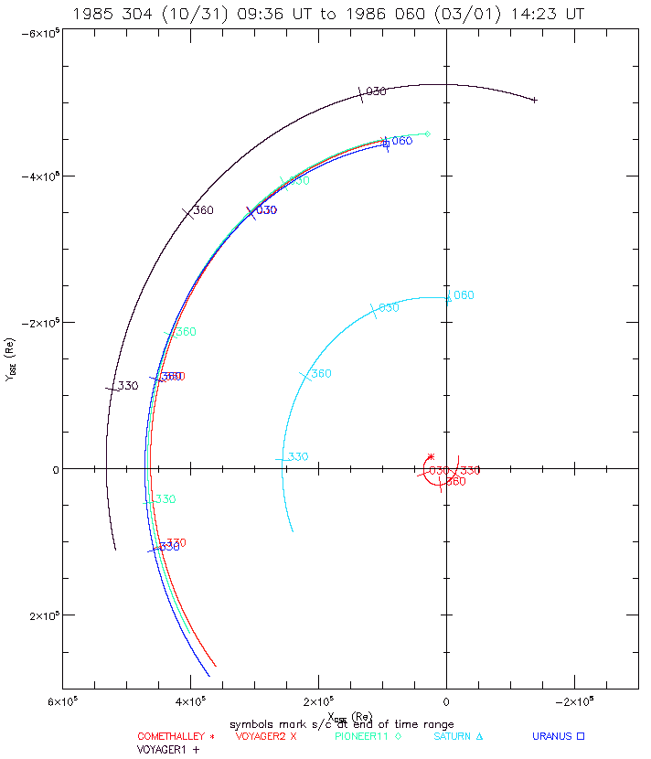
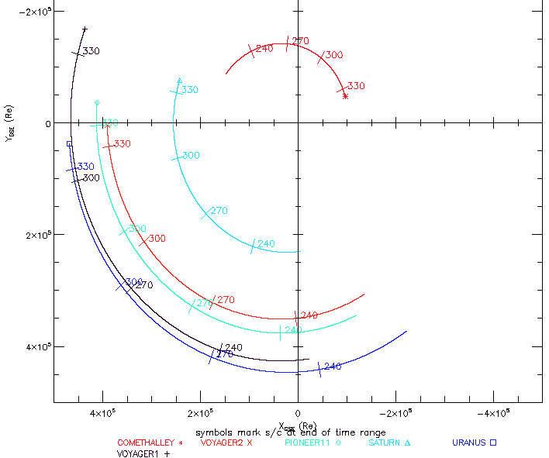
Many Fewer Satellite Assets at other Planets 1980 - 1986
KU Space Physics processed and carried out Research with Voyager data
Voyager 2 / Pioneer 11 Uranus Encounter 1986
Voyager 1 Uranus Encounter 1984
Voyager 1
Comet Halley
Voyager 1
Saturn
Saturn
Comet Halley
Voyager 2
Pioneer 11
Pioneer 11
Uranus
Uranus
Voyager 2

Slide 5
January 1-15, 1986
Bow Shock
Many Fewer Satellite Assets Around Earth
1980 - 1986
ISEE-1/2
AMPTE IRM
AMPTE CCE
Earth
Y_{GSE} (R_{E})
KU Space Physics carried out research with IMP-8 data
IMP-8
Magnetopause
X_{GSE} (R_{E})

Slide 6
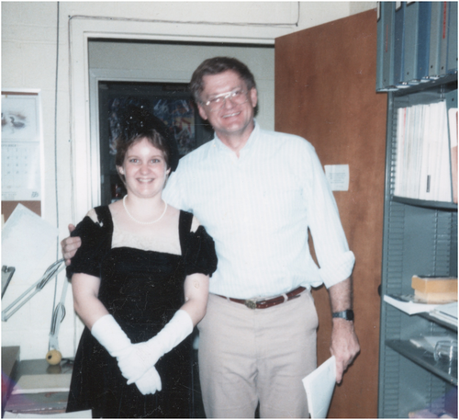
GONE WITH THE SOLAR WIND

